Slide 1

Data Structure

Slide 2
Introduction to Data Structure
Computer is an electronic machine which is used for data processing and manipulation.
When programmer collects such type of data for processing, he would require to store all of them in computers main memory.
In order to make how computer work we need to know
Representation of data in computer.
Accessing of data.
How to solve problem step by step.
For doing all of this task we used Data Structure

Slide 3
What is Data Structure
Data Structure can be defined as the group of data elements which provides an efficient way of storing and organizing data in the computer so that it can be used efficiently.
examples of Data Structures are arrays, Linked List, Stack, Queue, etc.
Data Structures are widely used in almost every aspect of Computer Science i.e. Operating System, Compiler Design, Artificial intelligence, Graphics and many more.
Data Structures are the main part of many computer science algorithms as they enable the programmers to handle the data in an efficient way.
It plays a vital role in enhancing the performance of a software or a program as the main function of the software is to store and retrieve the user’s data as fast as possible

Slide 4
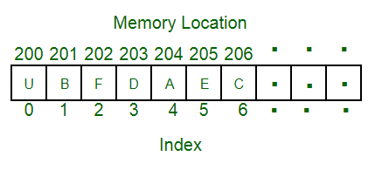
Data Structure
A data structure is a particular way of organizing data in a computer so that it can be used effectively.
For example, we can store a list of items having the same data-type using the array data structure.

Slide 5
The representation of particular data structure in the main memory of a computer is called as storage structure.
The storage structure representation in auxiliary memory is called as file structure.
It is define as the way of storing and manipulating data in organized form so that it can be used efficiently
Data Structure mainly specifies the following four things:
1)organization of data 2)accessing method 3)degree of associativity 4) processing alternative for information
Algorithm + Data Structure = Program
Data Structure study Covers the following points
1) Amount of memory require to store
2) Amount of time require to process
3) Representation of data in memory
4) Operations performs on data

Slide 6
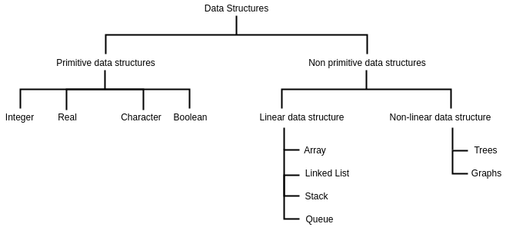

Slide 7
DATA TYPES A particular kind of data item, as defined by the values it can take, the Programming language used, or the operations that can be performed on it.
Primitive Data Structure
Primitive Data Structure are basic structure and directly operated upon by machine instructions.
Primitive data structures have different representations on different computers.
Integers, floats, character and pointers are example of primitive data structures.
These data types are available in most programming languages as built in type.
Integer: It is a data type which allows all values without fraction part. We can used it for whole numbers.
Float: It is a data type which is use for storing fraction numbers.
Character: It is a data type which is used for character values.
Pointer: A variable that hold memory address of another variable are called pointer.

Slide 8
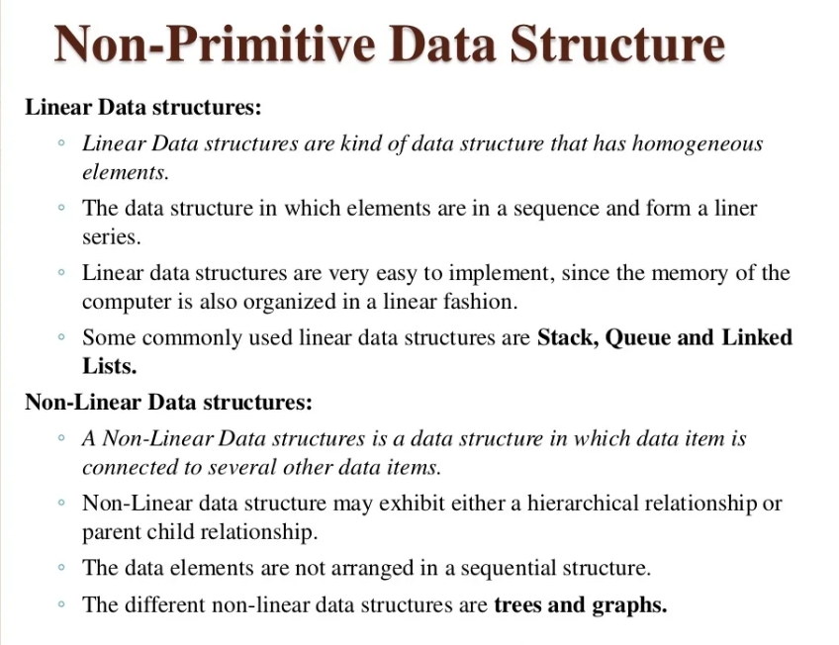

Slide 9
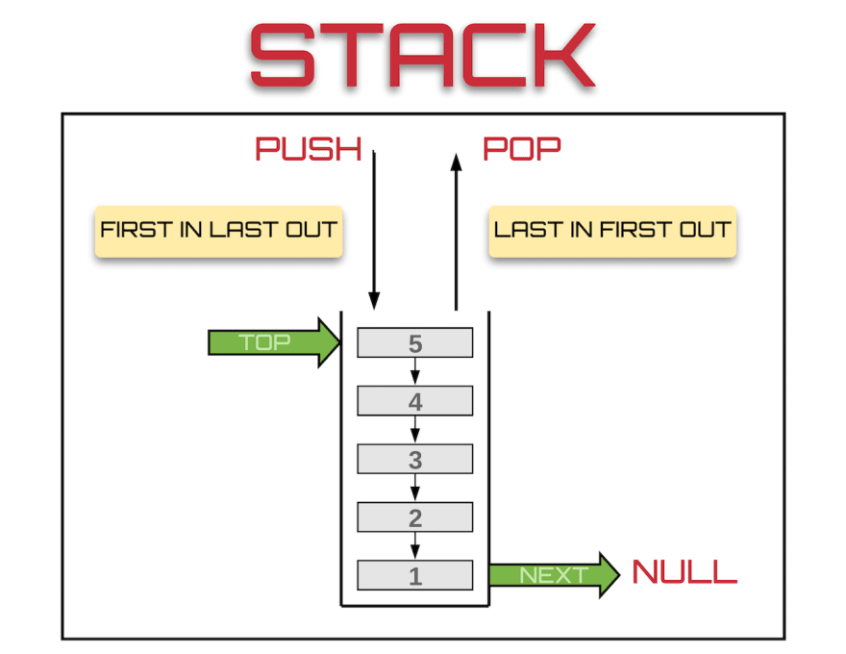
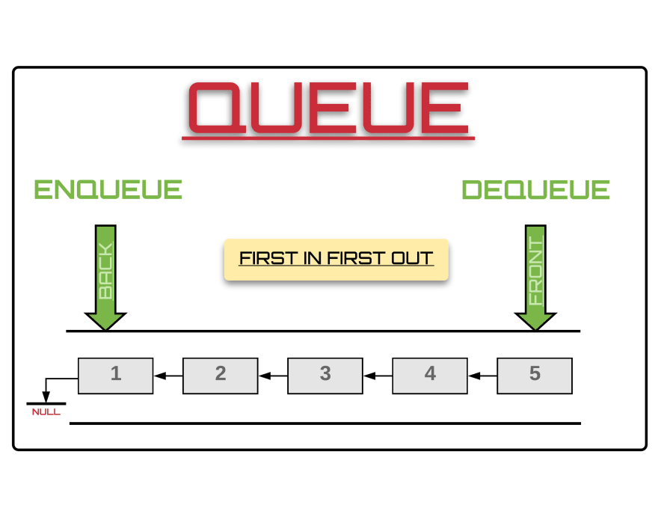
Example of Linear data structure are Stack and Queue
Stack
Stack is a data structure in which insertion and deletion operations are performed at one end only.
The insertion operation is referred to as ‘PUSH’ and deletion is referred as ‘POP’ operation
Stack is also called as Last In First Out (LIFO) data structure.
Queue
The data structure which permits the insertion at one and deletion at another end, known as Queue.
End at which deletion is occurs is known as FRONT end and another end at which insertion occurs is known as REAR end.
Queue is also called as First In First Out (FIFO)

Slide 10
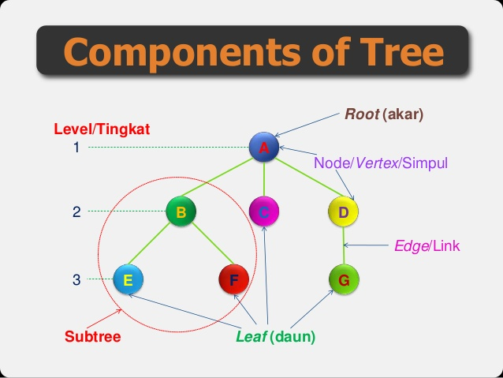
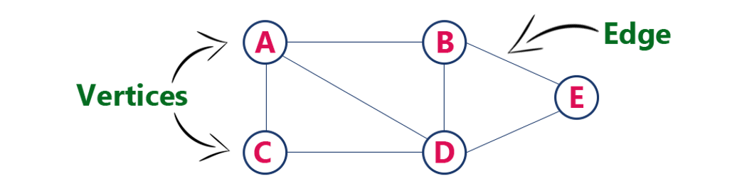
Non-Linear Data Structure
Non linear DS are those data structure in which data items are not arranged in a sequence.
Example on Non Linear DS are Tree and Graph.
TREE
A Tree can be define as finite data items (nodes) in which data items are arranged in branches and sub branches
Tree represent the hierarchical relationship between various elements
Tree consist of nodes connected by edge, the represented by circle and edge lives connecting to circle.
Graph
Graph is collection of nodes (information) and connecting edges (Logical relation) between nodes.
A tree can be viewed as restricted graph
Graph have many types: 1) Simple graph 2) Mixed graph 3) Multi graph 4) Directed graph 5) Un-directed graph
Components of Graph

Slide 11
Difference Between Linear and Non Linear Data Structure
Linear Data Structure
Non – Linear Data Structure
Every item is related to its previous and next item.
Data is arranged in linear sequence.
Data items can be traversed in a single run
E.g. Array, Stacks, Linked list, Queue
Implementation is easy.
Every item is attached with many other items.
Data is not arranged in sequence.
Data cannot be traversed in a single run.
E.g. Tree, Graph
Implementation is difficult.

Slide 12
Operation on Data Structures Design of efficient data structure must take operations to be performed on the DS into account. The most commonly used operations on DS are broadly categorized into following types
Create: This operation results in reserving memory for program elements. This can be done by declaration statement Creation of DS may take place either during compile-time or run-time.
Destroy: This operation destroy memory space allocated for specified data structure .
Selection: This operation deals with accessing a particular data within a data structure.
Updation: It updates or modifies the data in the data structure.
Searching: It finds the presence of desired data item in the list of data items, it may also find locations of all elements that satisfy certain conditions.
Sorting: This is a process of arranging all data items in a DS in particular order, for example either ascending order or in descending order.
Splitting: It is a process of partitioning single list to multiple list.
Merging: It is a process of combining data items of two different sorted list into single sorted list.
Traversing: It is a process of visiting each and every node of a list in systematic manner.

Slide 13
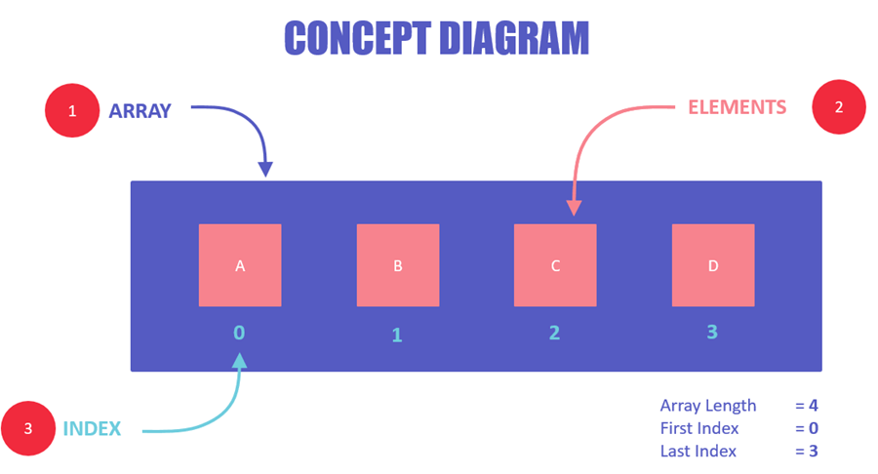
What are Arrays?
Array is a container which can hold a fix number of items and these items should be of the same type.
Most of the data structures make use of arrays to implement their algorithms.
Following are the important terms to understand the concept of Array.
Element − Each item stored in an array is called an element.
Index − Each location of an element in an array has a numerical index, which is used to identify the element.
An array is a container of elements.
Elements have a specific value and data type, like "ABC", TRUE or FALSE, etc.
Each element also has its own index, which is used to access the element.

Slide 14
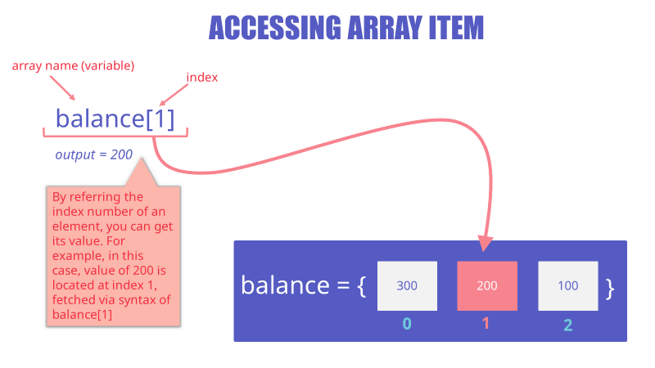
How to access a specific array value?
You can access any array item by using its index
Syntax
arrayName[indexNum]
Example
balance[1]
Here, we have accessed the second value of the array using its index, which is 1. The output of this will be 200, which is basically the second value of the balance array.

Slide 15
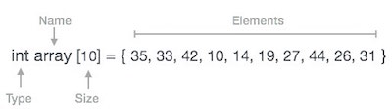
Array Representation
Arrays can be declared in various ways in different languages. For illustration, let's take C array declaration.

Slide 16
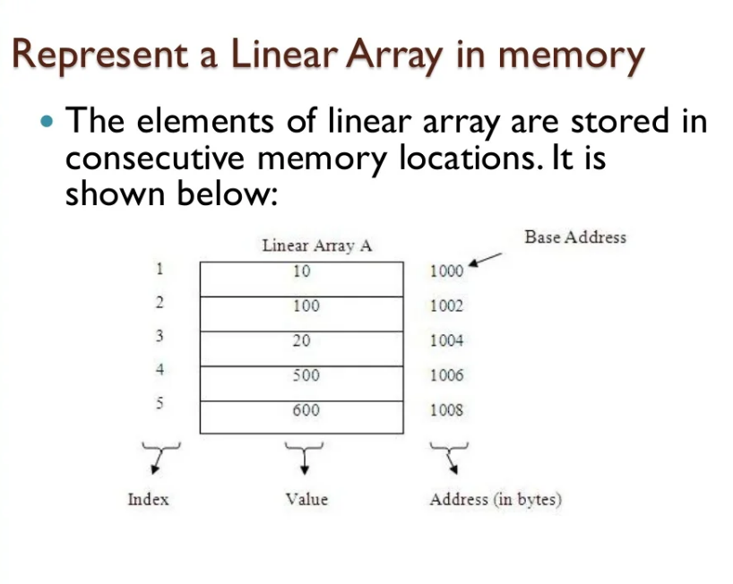

Slide 17
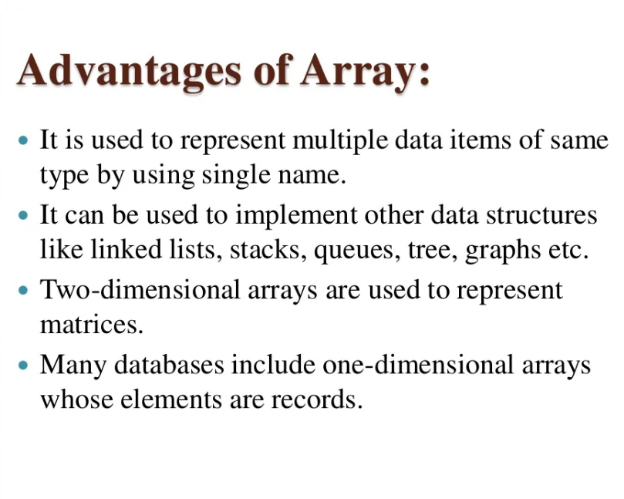

Slide 18
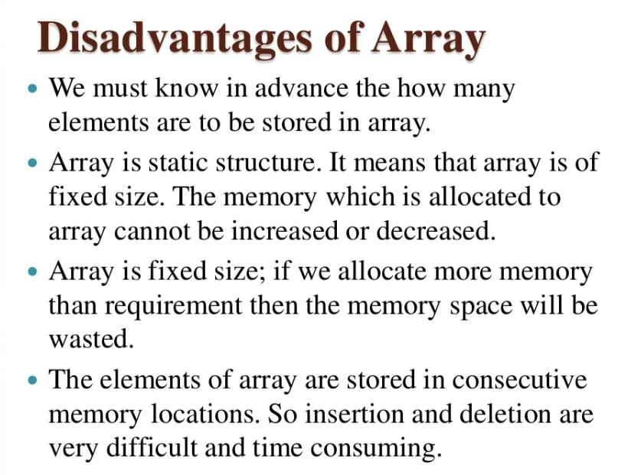

Slide 19
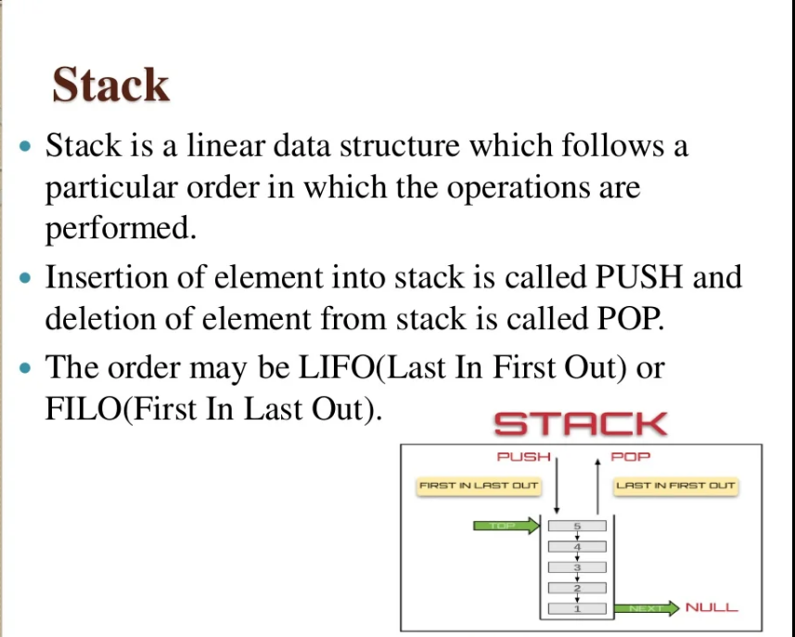

Slide 20
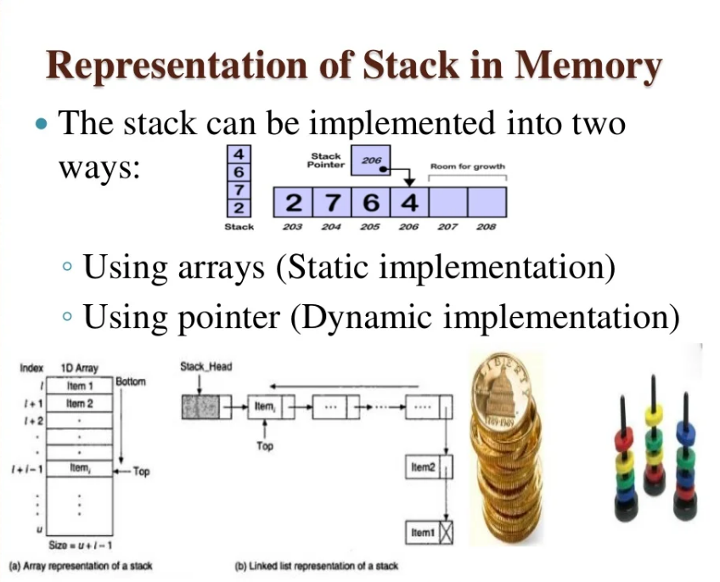

Slide 21
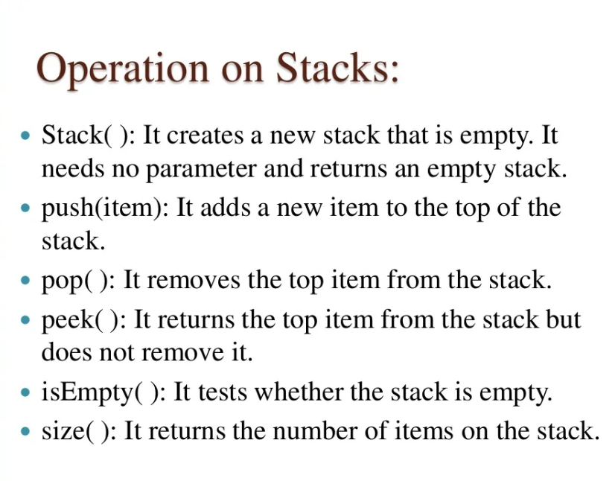

Slide 22
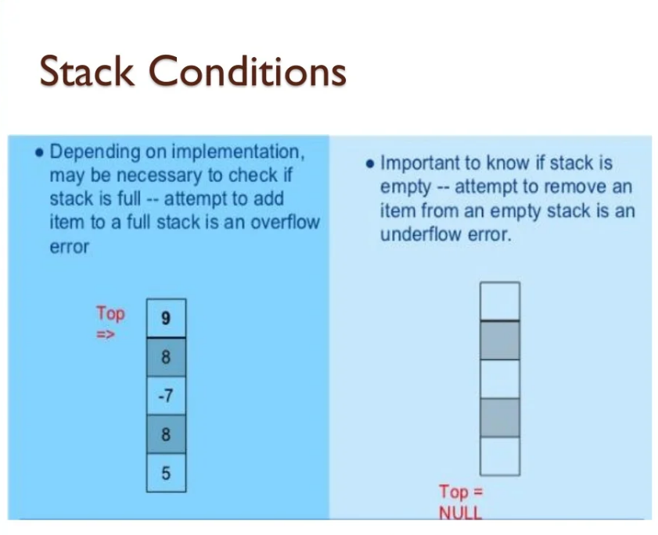

Slide 23
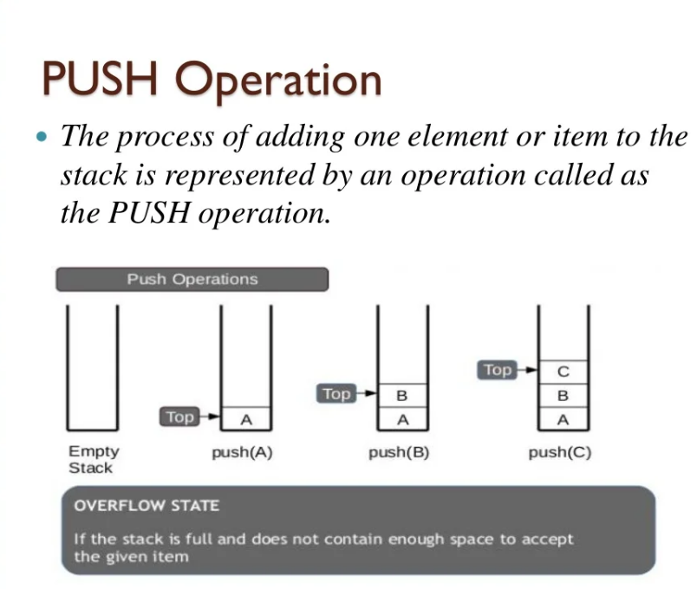

Slide 24
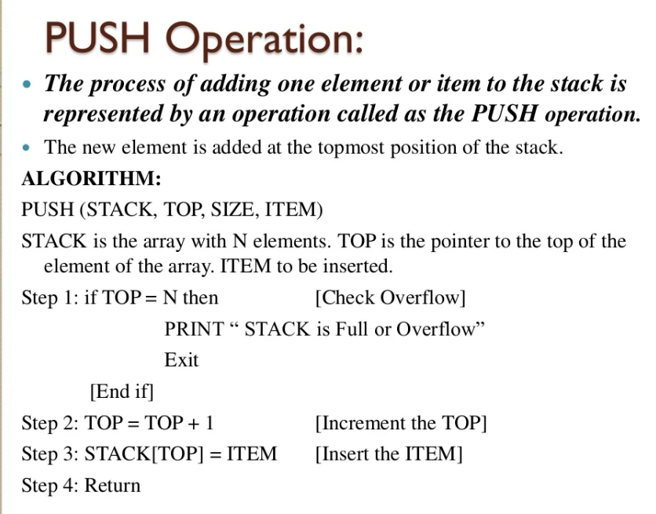

Slide 25
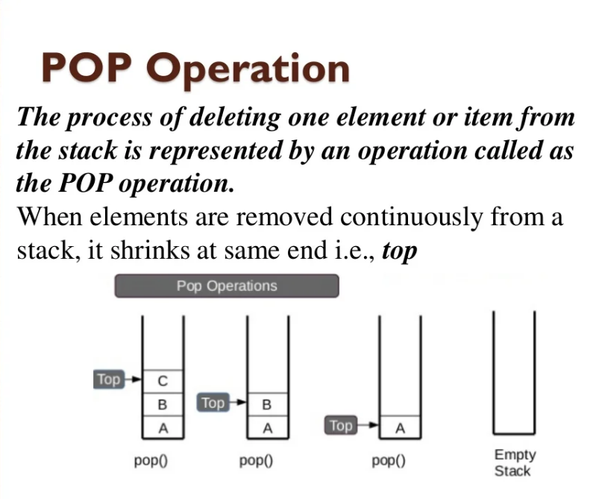

Slide 26
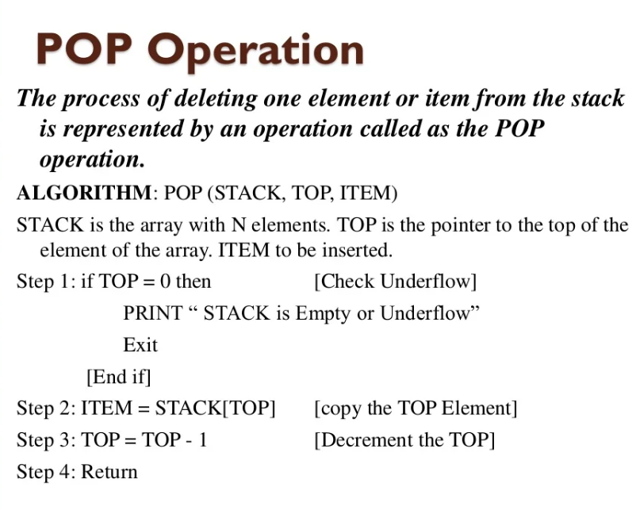

Slide 27
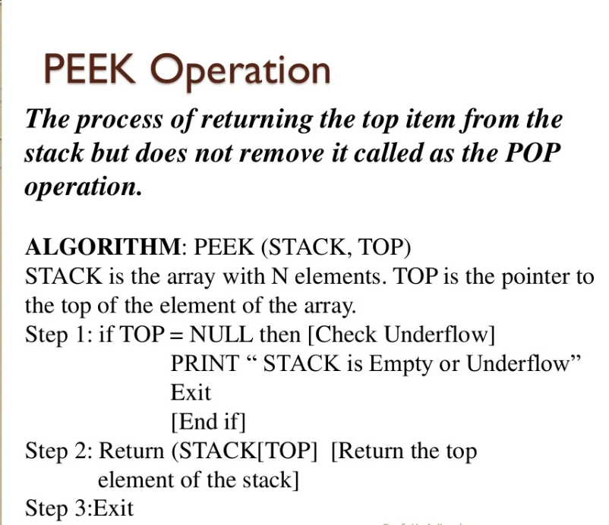

Slide 28
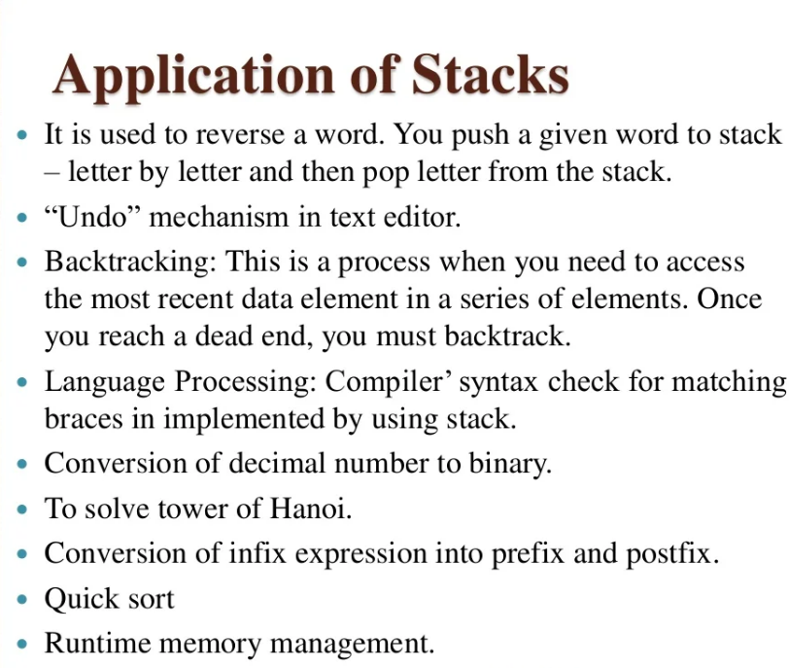

Slide 29
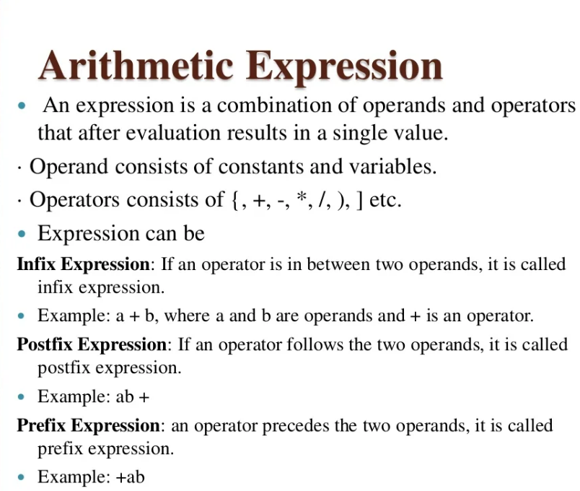

Slide 30
ALGORITHM TO CONVERT INFIX TO POSTFIX EXPRESSION
1. Scan the infix expression from left to right. 2. If the scanned character is an operand, output it. 3. Else, 1 If the precedence of the scanned operator is greater than the precedence of the operator in the stack(or the stack is empty or the stack contains a ‘(‘ ), push it. 2 Else, Pop all the operators from the stack which are greater than or equal to in precedence than that of the scanned operator. After doing that Push the scanned operator to the stack. (If you encounter parenthesis while popping then stop there and push the scanned operator in the stack.) 4. If the scanned character is an ‘(‘, push it to the stack. 5. If the scanned character is an ‘)’, pop the stack and output it until a ‘(‘ is encountered, and discard both the parenthesis. 6. Repeat steps 2-6 until infix expression is scanned. 7. Print the output 8. Pop and output from the stack until it is not empty.

Slide 31
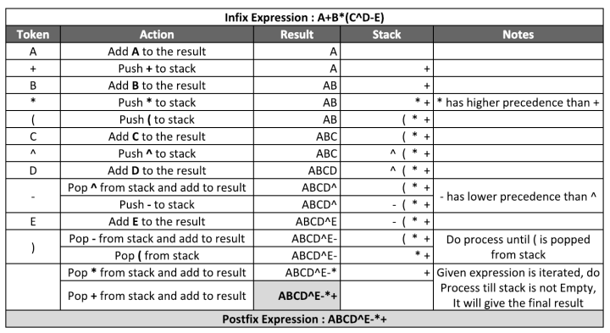

Slide 32
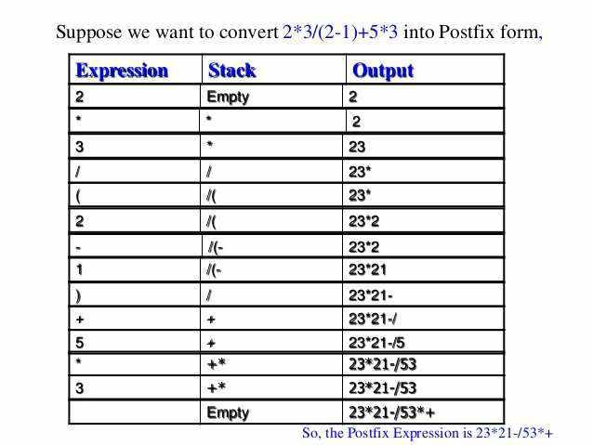

Slide 33
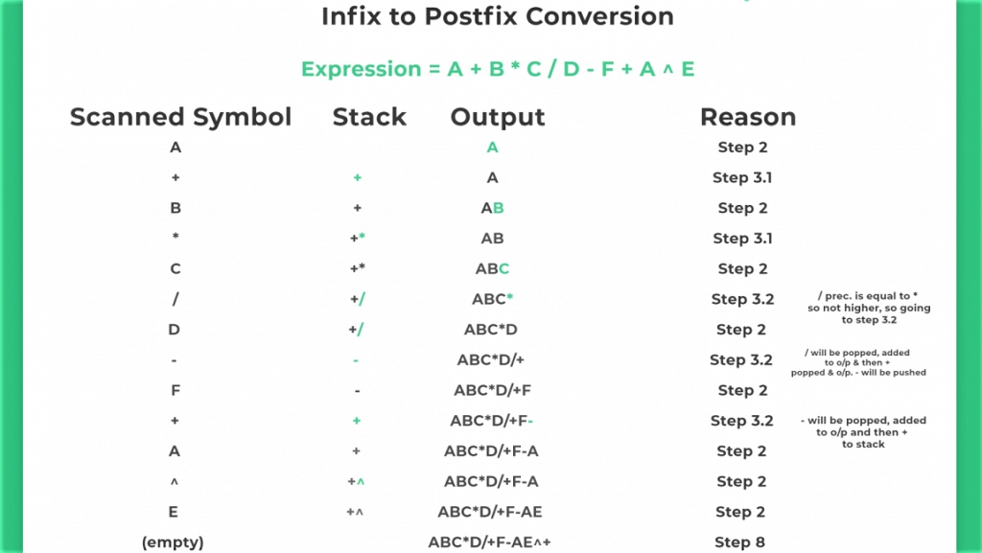

Slide 34
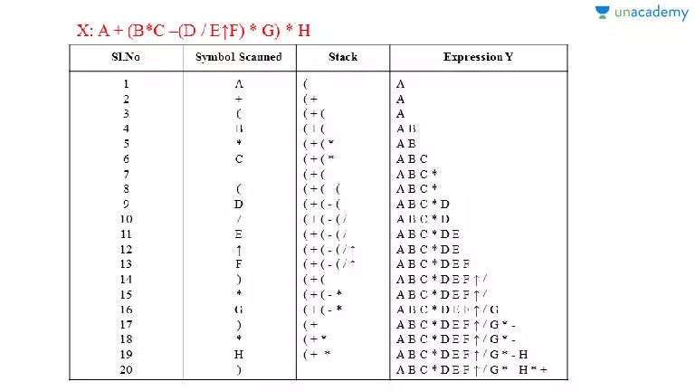

Slide 35
Evaluation of Postfix Expression
1) Create a stack to store operands (or values). 2) Scan the given expression and do the following for every scanned element. …..a) If the element is a number, push it into the stack …..b) If the element is an operator, pop operands for the operator from the stack. Evaluate the operator and push the result back to the stack 3) When the expression is ended, the number in the stack is the final answer

Slide 36
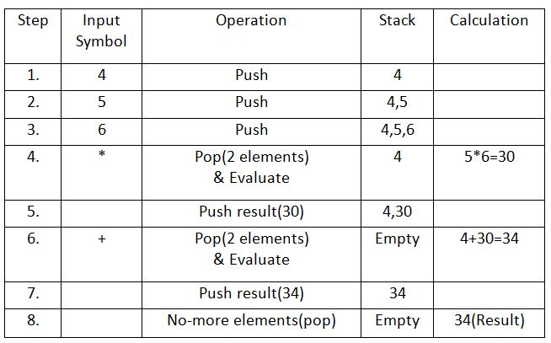

Slide 37
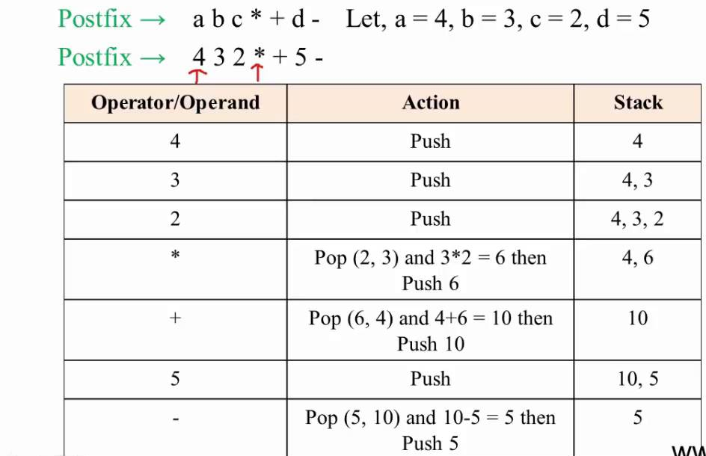

Slide 38
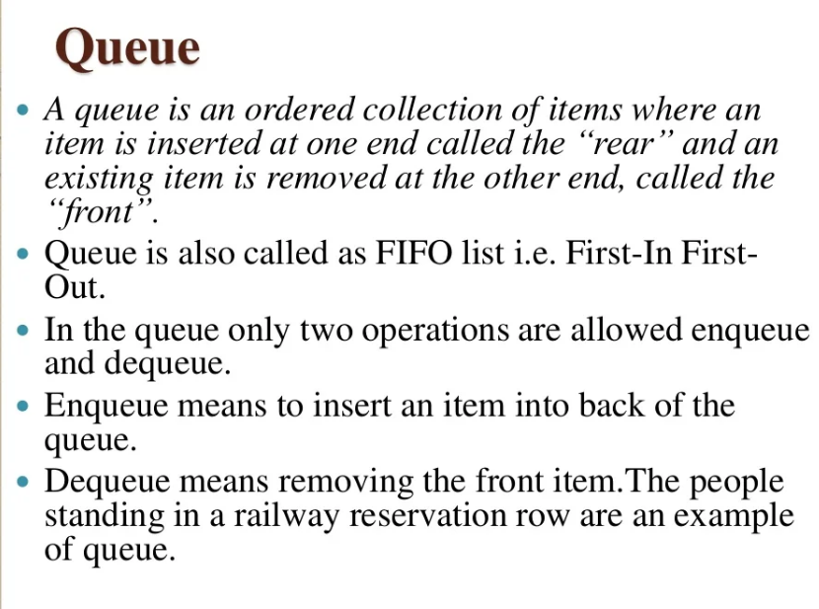

Slide 39
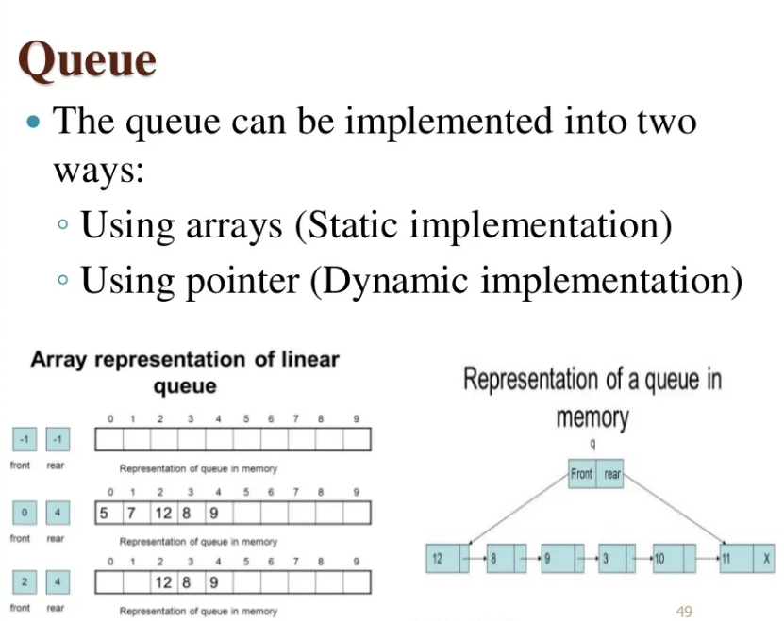

Slide 40
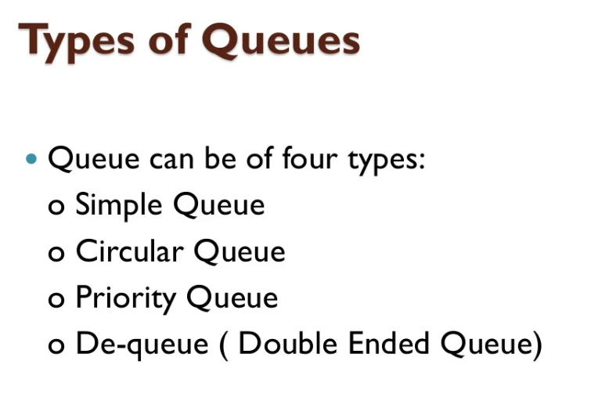

Slide 41
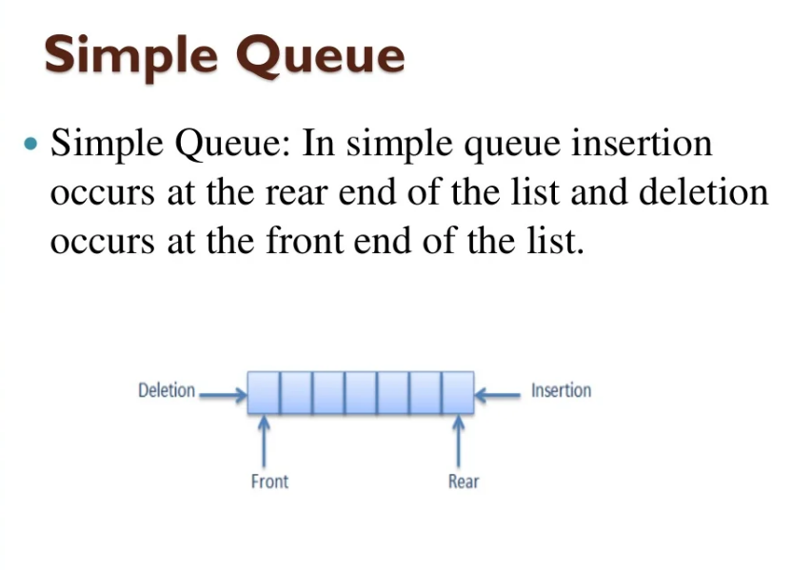

Slide 42
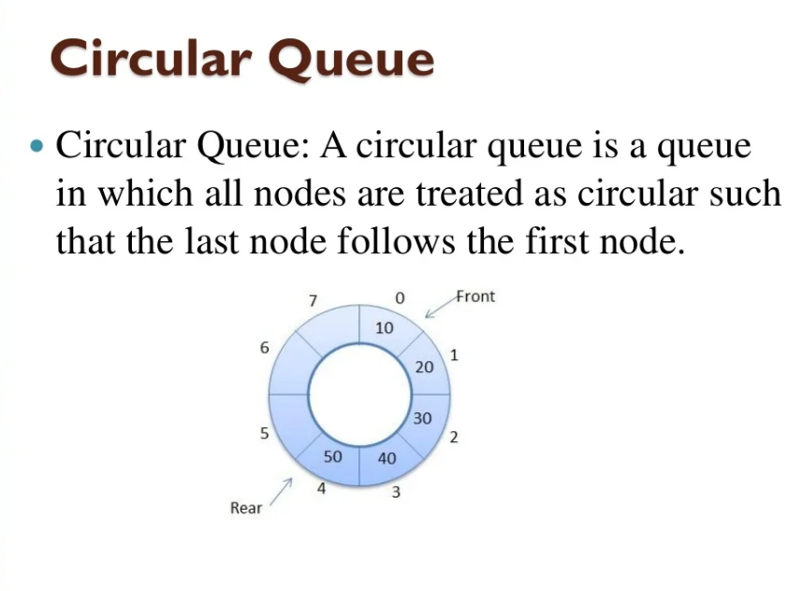

Slide 43
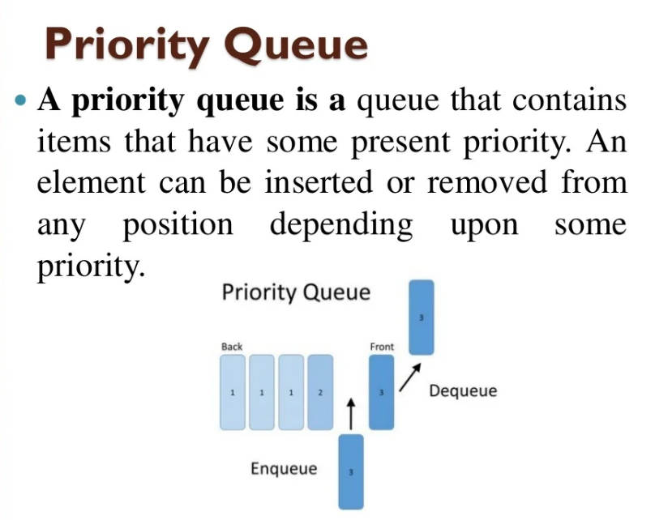

Slide 44
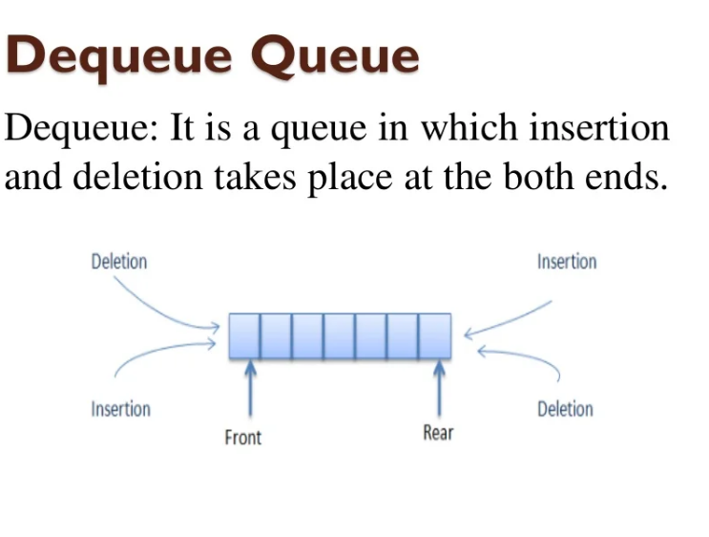

Slide 45
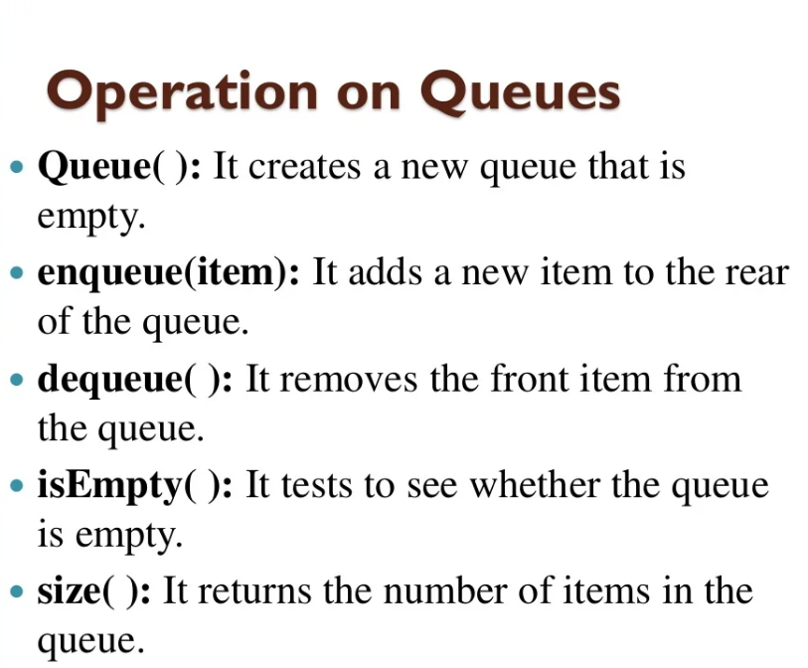

Slide 46
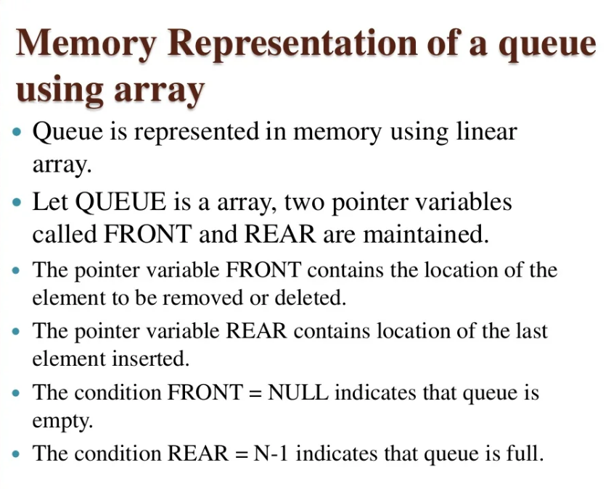

Slide 47
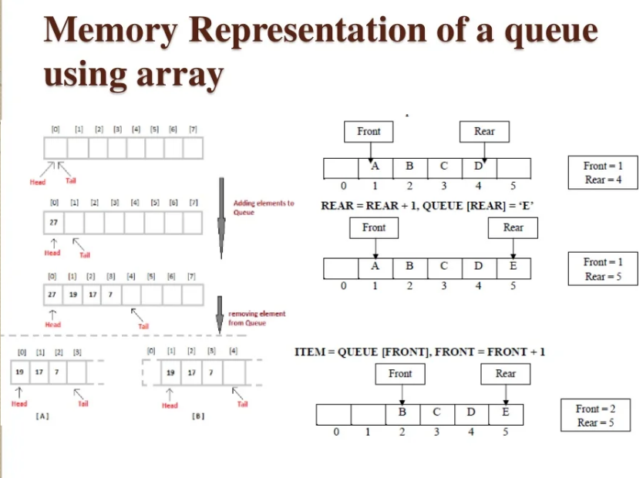

Slide 48
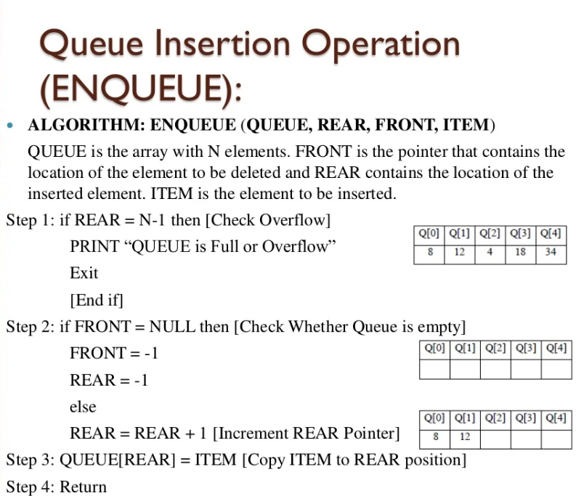

Slide 49
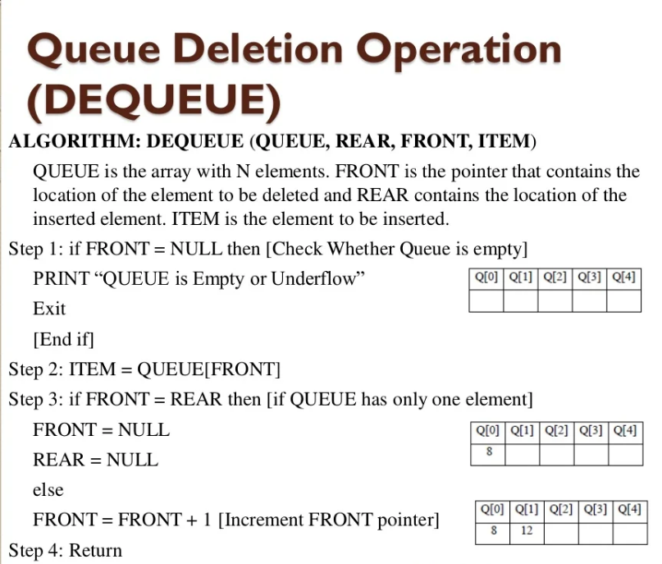

Slide 50
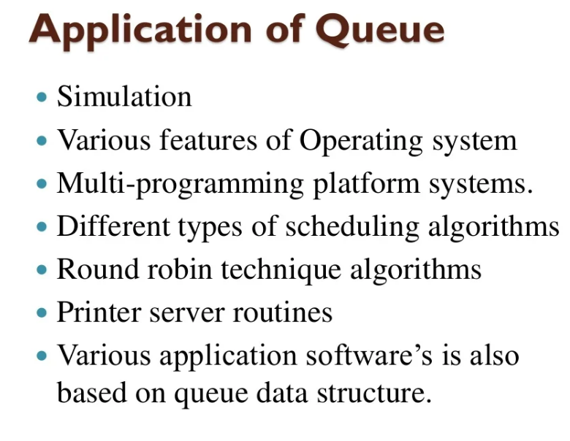

Slide 51
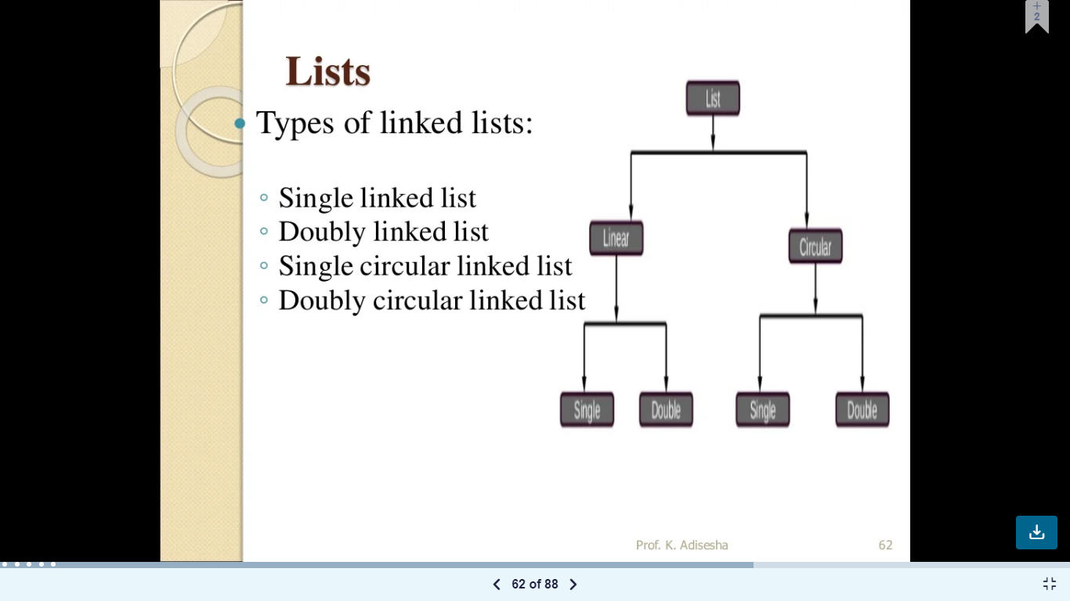

Slide 52
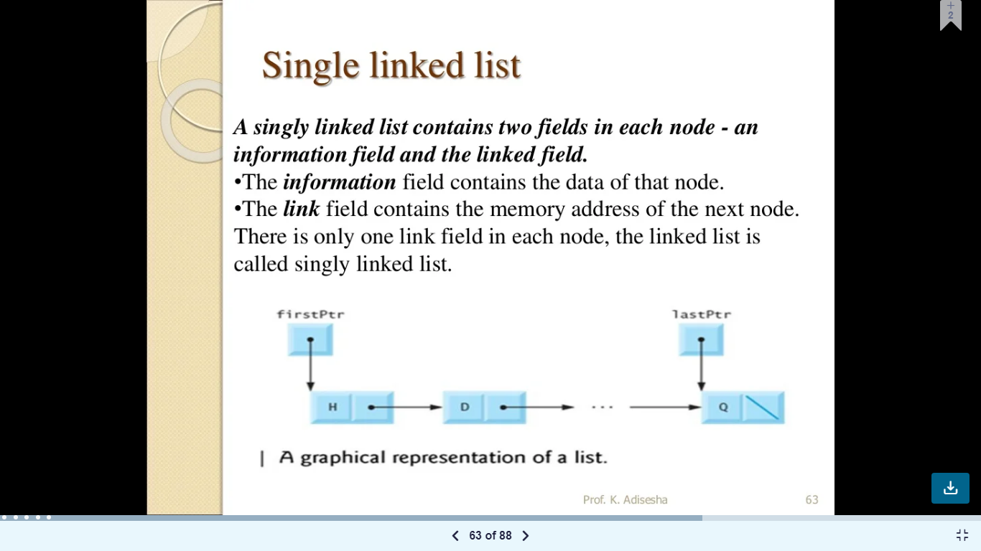

Slide 53
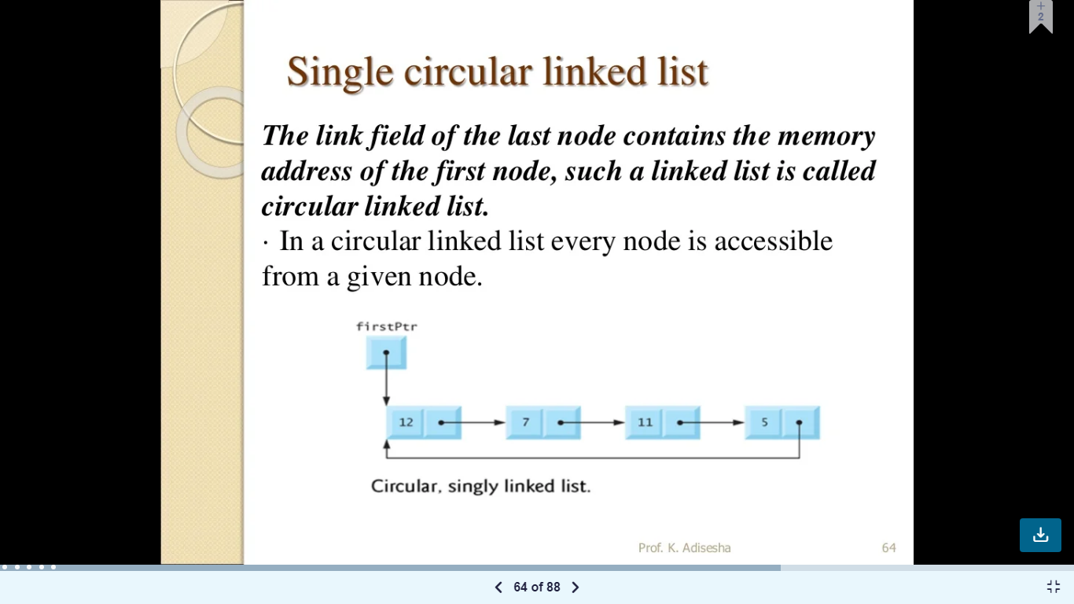

Slide 54
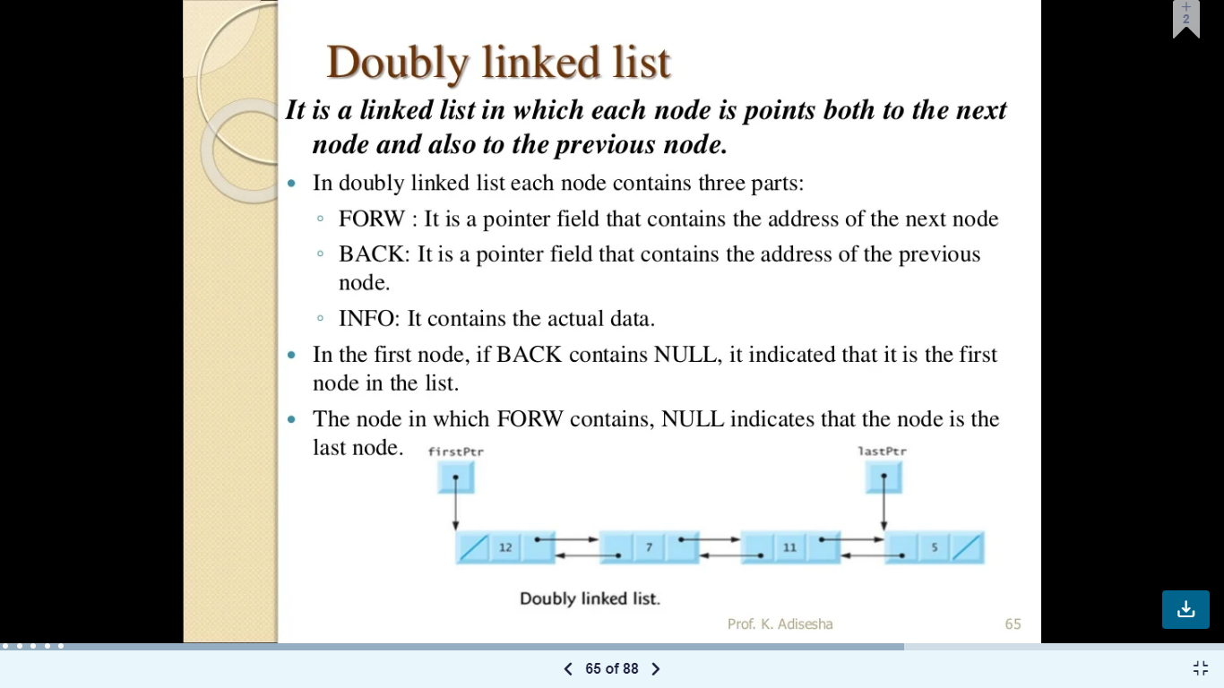

Slide 55
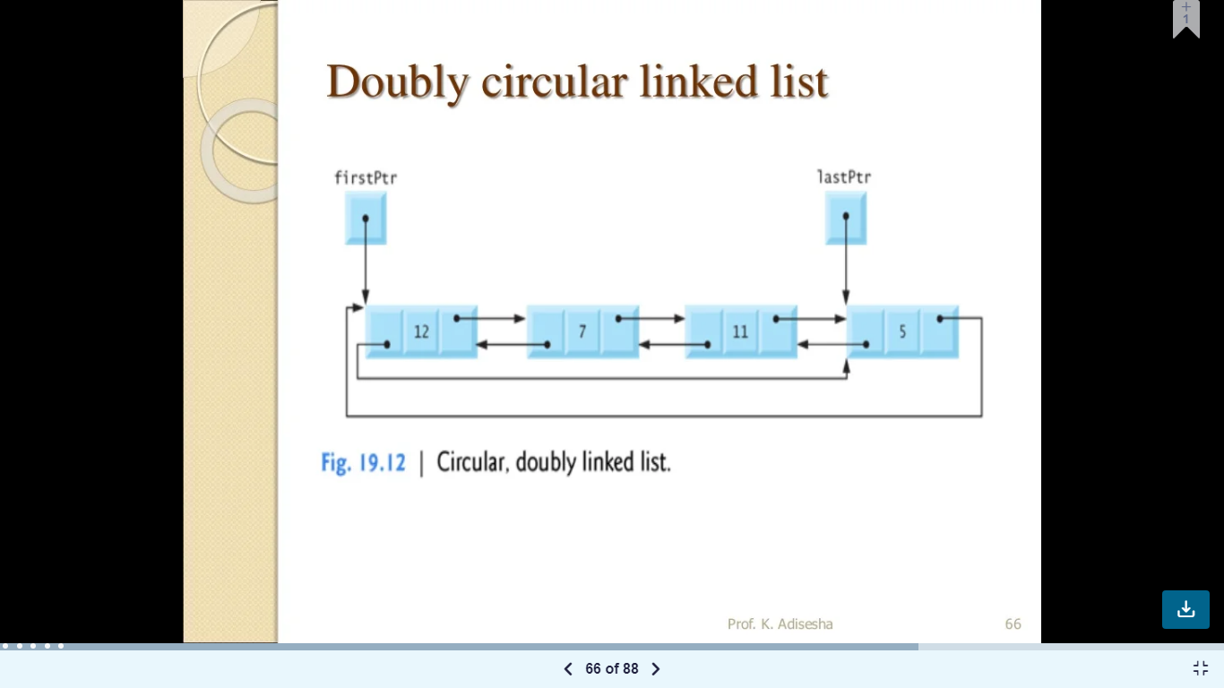

Slide 56
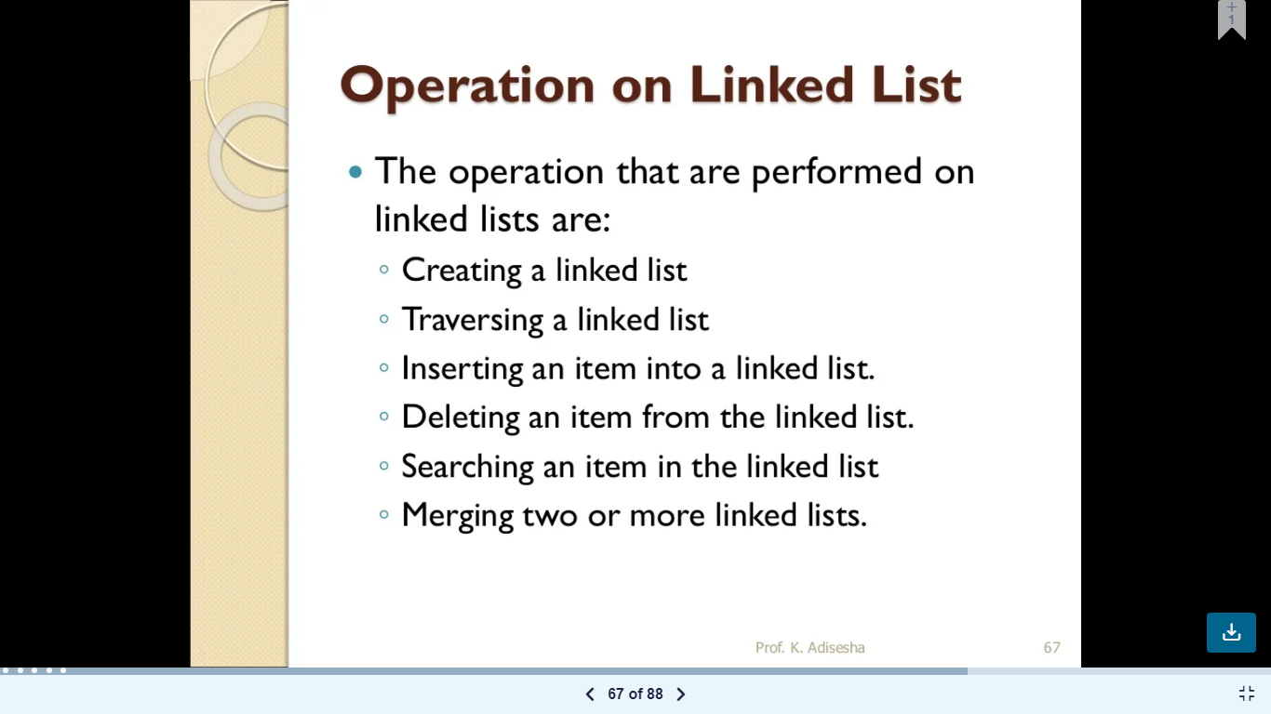

Slide 57
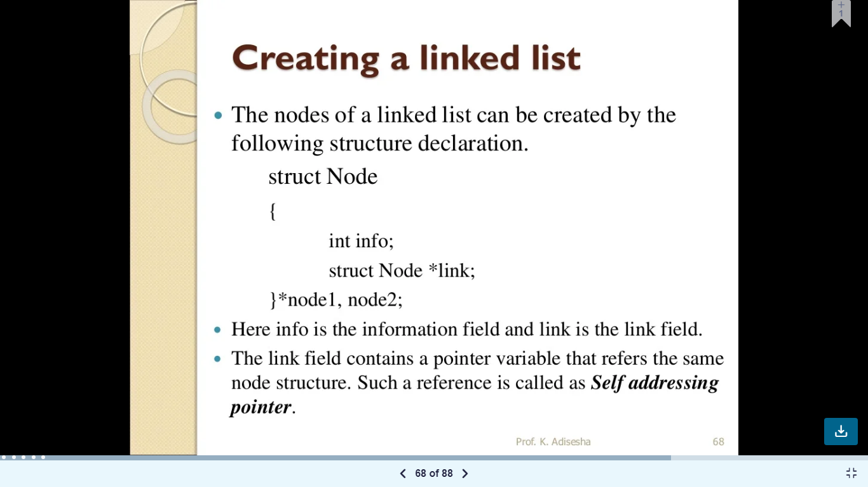

Slide 58


Slide 59


Slide 60


Slide 61


Slide 62


Slide 63


Slide 64


